Slide 1
CSI2005 Principles of Compiler Design
MODULE – 1
Dr. WI. Sureshkumar
Associate Professor
School of Computer Science and Engineering (SCOPE)
VIT Vellore
wi.sureshkumar@vit.ac.in
SJT413A34

Slide 2
Regular Expression
Let Σ be a given alphabet. Then
∅ , ε , and any a∈Σ are all regular expressions. These are called
primitive regular expressions.
2) If r₁ and r₂ are regular expressions, then
- r₁ / r₂ is a regular expression.
- r₁ ⋅ r₂ is a regular expression.
r₁* is a regular expression.
(r₁ ) is a regular expression.
3) A string is a regular expression, if and only if it can be derived from the primitive regular expressions by a finite number of applications of rules in (2).

Slide 3
Regular Expression
Check whether the given string is a regular expression,
={ a, b, c}, the string (a/b . c)* . (c / ∅)
r₁ = a , r₂ = b , r₃ = c
r₄ = r₂ . r₃ = b . c
r₅ = r₁ / r₄ = a / b . c
r₆ = (r₅) = (a / b . c)
r₇ = r₆* = (a / b . c)*
r₈ = ∅
r₉ = r₃ / r₈ = c / ∅
r₁₀ = (r₉)= (c / ∅)
r₁₁ = r₇ . r₁₀ = (a / b . c)* . (c / ∅)

Slide 4
Languages associated with regular expressions
The language L(r) denoted by a regular expression r is defined by the following rules,
∅ is a r.e denoting the empty set L (∅) = {∅}
ε is a r.e denoting the empty set L (ε) = {ε}
For any a∈Σ is a r.e denoting the set L (a) = {a}
If r₁ and r₂ are regular expressions, then
4) L (r₁ / r₂) = L{r₁} U L{r₂}
5) L (r₁ . r₂) = L{r₁}.L{r₂}
6) L ((r₁)) = L(r₁)
7) L (r₁*) = (L (r₁))*

Slide 5
Languages associated with regular expressions
Exhibit the language L(a* . (a / b)) in set notation
L(a* . (a / b)) = L(a*) . L( (a / b))
= (L(a))*. L(a / b))
= (L(a))*. L(a) U L(b)
= { a }*. { a } U { b }
= {ε, a, aa, aaa,. . . }. { a, b}
= {a, aa, aaa, aaaa,. . . ,b, ab, aab, aaab,. . . }

Slide 6
Languages associated with regular expressions
r = (a / b)*. (a / bb), find L(r)
L(r) = L((a / b)*. (a / bb))
= L((a / b)*). L(a / bb)
= (L(a / b))*. L(a / bb)
= (L(a) U L(b))* . L(a) U L(bb)
= {a, b}* . {a} U {b}.{b}
= {a, b}* . {a} U {bb}
= {a, b}* . {a, bb}
= {ε, a, b, aa, ab, ba, bb,. . .} . {a, bb}
= {a, aa, ba, aaa, aba, baa, bba,. . .,bb, abb, bbb, aabb, abbb, . . .}

Slide 7
Examples
Describe the following sets by regular expressions
L₁ = the set of all strings of 0’s and 1’s ending with 00
L₂ = the set of all strings of 0’s and 1’s and beginning with 0 and ending with 1
L₃ = {ε, aa, aaaa, . . . }
The set of all strings of 0’s and 1’s with at least two consecutive zeros
The set of all strings of a’s and b’s whose length is divisible by 6
The set of all strings of a’s and b’s whose 5th last symbol is b
The expression r = (aa)* (bb)*b denotes the set of strings with an even number of a’s followed by an odd number of b’s
L₄ = {a^{n} b^{m} / n ≥ 4 , m ≤ 3}

Slide 8
Examples
1) (0 / 1)*00
0(0 / 1)*1
(aa)*
(0 / 1)*00(0 / 1)*
[(a / b)⁶]*
(a / b)*b(a / b)⁴
7) L(r) = {a^{2n} b^{2m+1} / n ≥ 0 , m ≥ 0 }
8) aaaaa*(ε / b / bb / bbb)

Slide 9
Regular expression to ε-NFA
Theorem: Let r be a regular expression, then there exists some NFA with ε-moves that accept L(r). Consequently, L(r) is a regular language.
Proof: We begin with automata that accepts the language for primitive regular expressions ∅ , ε , and any a∈Σ
a) NFA accepts ∅
b) NFA accepts ε c) NFA accepts a∈Σ
q₀
q_{f}
ε
q₀
a
q_{f}
q₀
q_{f}

Slide 10
Regular expression to ε-NFA
ii) NFA accepts L(r)
iii) NFA accepts L(r₁/r₂)
M(r)
M(r₁)
ε
ε
M(r₂)
ε
ε

Slide 11
Regular expression to ε-NFA
iii) NFA accepts L(r₁.r₂)
iii) NFA accepts L(r₁*)
M(r₁)
M(r₂)
ε
ε
ε
M(r₁)
ε
ε
ε

Slide 12
Examples
The set of integers
(1+2+. . . +9)(0+1+. . . +9)*
2)The set of decimal numbers
(1+2+. . . +9)(0+1+. . . +9)*. (0+1+. . . +9)*
3) Strings over {a, b} and length multiple of 3
[(a + b)(a + b)(a + b)]*

Slide 13
Examples
(0 + 01)*
(a + b)*b(a + b)*
(a+b)*abb
aa* + ab a*b*
(abab)* + (aa*+ b)*
((00*)*1)*
(01)* + 1(01)* + (01)*0 + 1(01)*0

Slide 14
(0 / 01)*
0
1
01
0
1
0
ε
1

Slide 15
0 / 01
(0 / 01)*
0
ε
ε
ε
ε
0
ε
1
ε
0
ε
ε
ε
ε
ε
ε
0
ε
1
ε

Slide 16
(a/b)*
ε
a
ε
ε
ε
ε
ε
b
ε
ε

Slide 17
(a / b)*b(a / b)*
ε
ε
a
a
ε
ε
ε
ε
ε
b
ε
ε
ε
ε
ε
ε
b
ε
b
ε
ε

Slide 18
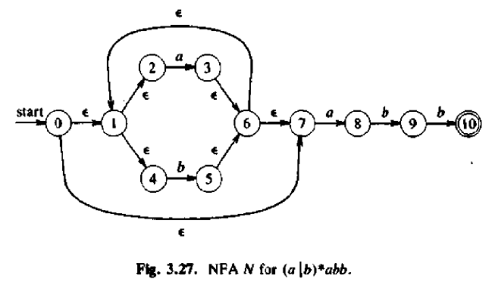

Slide 19
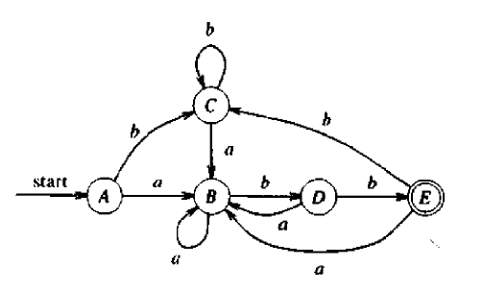

Slide 20
Direct Method – (RE to DFA)
Let r be the regular expression. Then the augmented regular expression is denoted by r#
r = (a/b)*bb r# = (a/b)*bb#
Construct a syntax tree for r#
Traverse the tree to construct the following functions
nullable() , firstpos() , lastpos() , followpos()
Construct DFA by using subset construction method.

Slide 21
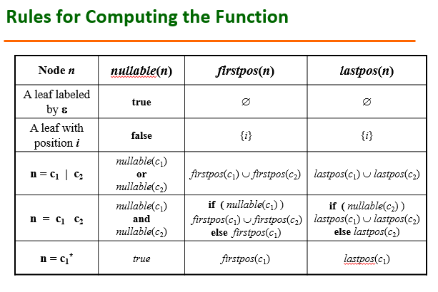

Slide 22
Given (a/b)*abb , then augmented r.e is (a/b)*abb#
#
6
b
5
b
b
4
4
*
*
a
a
3
|
|
b
a
b
a
1
2

Slide 23
{ 6 }
#
{ 6 }
{ 5 }
b
{ 5 }
b
{ 4 }
{ 4 }
*
{ 3 }
a
{ 3}
|
{ 1 }
a
{ 1 }
{ 2 }
b
{ 2 }

Slide 24
{ 1, 2, 3 }
{ 6 }
{ 1, 2, 3 }
{ 5 }
{ 6 }
#
{ 6 }
{ 1, 2, 3 }
{ 4 }
{ 5 }
b
{ 5 }
{ 1, 2, 3 }
{ 3}
b
{ 4 }
{ 4 }
{ 1, 2 }
*
{ 1, 2 }
{ 3 }
a
{ 3}
{ 1, 2 }
|
{ 1, 2 }
{ 1 }
a
{ 1 }
{ 2 }
b
{ 2 }

Slide 25
Computing followpos()
The function followpos( i ) tells us what position can follow position i in the syntax tree. To find followpos( i ), we need 2 rules:
1) If n is a cat-node with left child c₁ and right child c₂ , i is a position in lastpos(c₁) , then all positions in firstpos(c₂) are in followpos( i ).
2) If n is a star-node, and i is a position in lastpos(n) , then all positions in firstpos(n) are in followpos( i ).

Slide 26
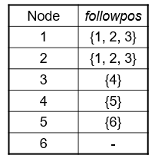
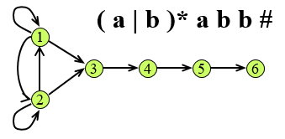

Slide 27
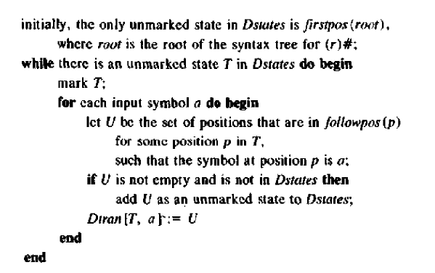

Slide 28
A = {1, 2, 3} position(a) = 1, 3 position(b) = 2, 4, 5
Dtran[A, a] = followpos(1) U followpos(3)
= {1, 2, 3} U {4} = {1, 2, 3, 4} = B
Dtran[A, b] = followpos(2)
= {1, 2, 3} = {1, 2, 3} = A
_{A}
_{b}
_{a}
_{A}
_{B}

Slide 29
B = {1, 2, 3, 4} Dtran[B, a] = followpos(1) U followpos(3)
= {1, 2, 3} U {4} = {1, 2, 3, 4} = B
Dtran[B, b] = followpos(2) U followpos(4)
= {1, 2, 3} U {5} = {1, 2, 3, 5} = C
_{b}
_{a}
_{b}
_{A}
_{B}
_{C}
_{a}

Slide 30
C = {1, 2, 3, 5} Dtran[C, a] = followpos(1) U followpos(3)
= {1, 2, 3} U {4} = {1, 2, 3, 4} = B
Dtran[C, b] = followpos(2) U followpos(5)
= {1, 2, 3} U {6} = {1, 2, 3, 6} = D
_{b}
_{a}
_{a}
_{b}
_{b}
_{A}
_{B}
_{C}
_{D}
_{a}

Slide 31
D = {1, 2, 3, 6} Dtran[D, a] = followpos(1) U followpos(3)
= {1, 2, 3} U {4} = {1, 2, 3, 4} = B
Dtran[D, b] = followpos(2)
= {1, 2, 3} = {1, 2, 3} = A
_{b}
_{b}
_{a}
_{a}
_{b}
_{b}
_{A}
_{B}
_{C}
_{D}
_{a}
_{a}

Slide 32
Given (a/b)*a(a/b) , then augmented r.e is (a/b)*a(a/b)#
#
6
|
a
b
*
4
5
a
3
|
a
b
1
2

Slide 33
#
{ 6 }
{ 6 }
|
b
{ 5 }
{ 5 }
*
a
{ 4 }
{ 4 }
a
{ 3 }
{ 3 }
|
{ 1 }
a
{ 1 }
{ 2 }
b
{ 2 }

Slide 34
{ 1, 2, 3 }
{ 6 }
{ 1, 2, 3 }
{ 4, 5 }
#
{ 6 }
{ 6 }
{ 4, 5 }
|
{ 4, 5 }
{ 1, 2, 3 }
{ 3 }
b
{ 5 }
{ 5 }
*
a
{ 4 }
{ 1, 2 }
{ 1, 2 }
{ 4 }
a
{ 3 }
{ 3 }
|
{ 1, 2 }
{ 1, 2 }
b
{ 1 }
a
{ 2 }
{ 2 }
{ 1 }

Slide 35
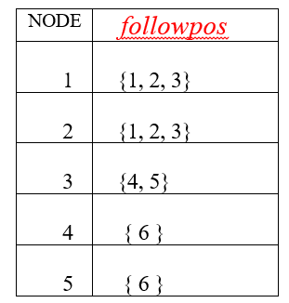
₄
₁
₆
₃
₂
₅

Slide 36
A = {1, 2, 3} position(a) = 1, 3, 4 position(b) = 2, 5
Dtran[A, a] = followpos(1) U followpos(3)
= {1, 2, 3} U {4, 5} = {1, 2, 3, 4, 5} = B
Dtran[A, b] = followpos(2)
= {1, 2, 3} = {1, 2, 3} = A
_{A}
_{b}
_{A}
_{a}
_{B}

Slide 37
B = {1, 2, 3, 4, 5} Dtran[B, a] = followpos(1)U followpos(3)U followpos(4)
= {1, 2, 3} U {4, 5} U {6} = {1, 2, 3, 4, 5, 6} = C
Dtran[B, b] = followpos(2) U followpos(5)
= {1, 2, 3}U{6} = {1, 2, 3, 6} = D
_{b}
_{A}
_{a}
_{a}
_{C}
_{B}
_{b}
_{D}

Slide 38
C = {1, 2, 3, 4, 5, 6} Dtran[C, a] = followpos(1)Ufollowpos(3)U followpos(4)
D = {1, 2, 3, 6} = {1, 2, 3} U {4, 5} U {6} = {1, 2, 3, 4, 5, 6} = C
Dtran[C, b] = followpos(2) U followpos(5)
= {1, 2, 3}U{6} = {1, 2, 3, 6} = D
Dtran[D, a] = followpos(1)Ufollowpos(3)
= {1, 2, 3} U {4, 5} = {1, 2, 3, 4, 5} = B
Dtran[D, b] = followpos(2)
= {1, 2, 3} = A
_{b}
_{A}
_{a}
_{a}
_{C}
_{B}
_{a}
_{b}
_{a}
_{b}
_{b}
_{D}

Slide 39
Construct DFA for the following regular expressions:
(a/b)*a(a/b) (a/b)
(a/b)*abb(a/b)*
(a/b)*a(a/b)(a/b)(a/b)
(a/b)*a(a/b)*

